Slide 1
Search
Chen-Yu Wei

Slide 2
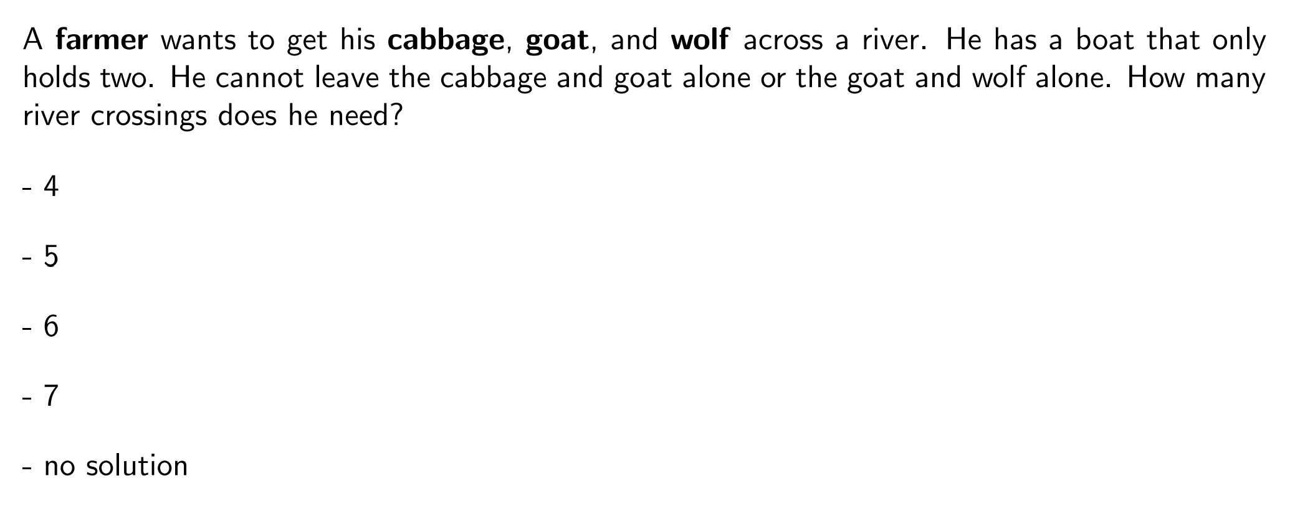
Question
https://stanford-cs221.github.io/autumn2023-extra/modules/search/modeling.pdf

Slide 3
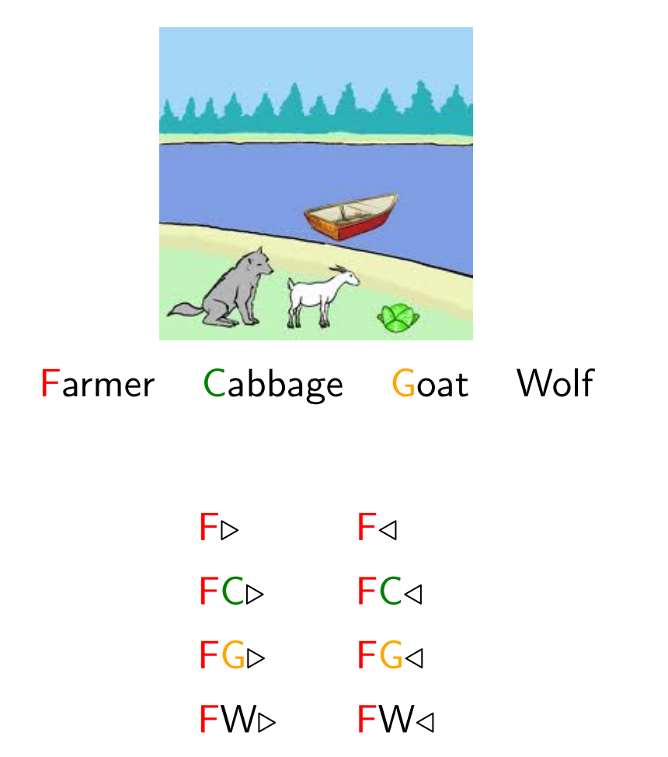
Model the Problem
How many different “states”?
How many different “actions”?

Slide 4
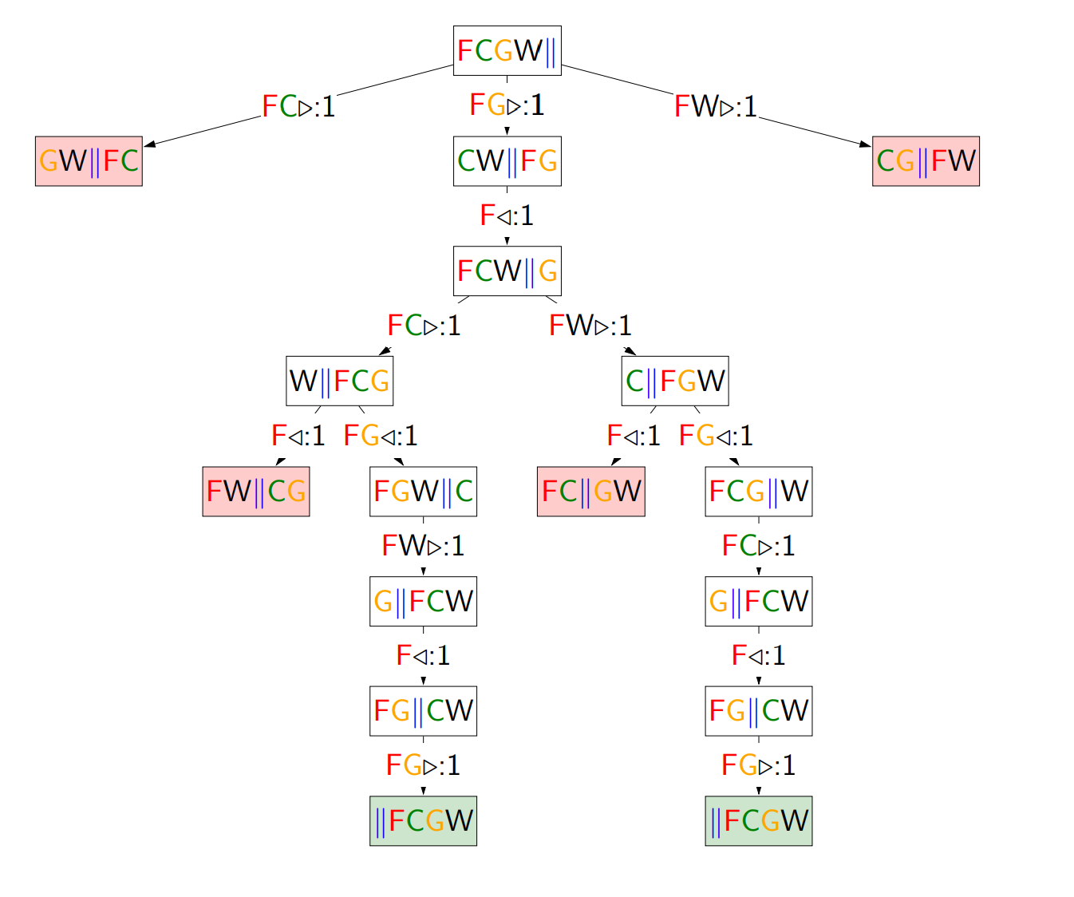
Build a Search Tree

Slide 5
Search Problem
State space
Initial state
Goal test: Given a state, return whether the state is a goal
Action
Successor function: Given current state and action, return the new state
(The cost of an action)

Slide 6
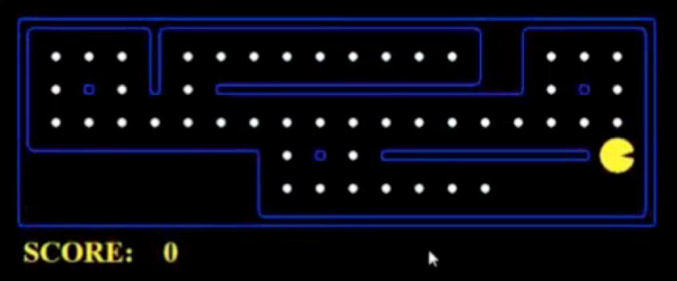
Example: PACMAN
Eat all dots
States: {(x,y), dot booleans}
Actions: NSEW
Successor: update location and possibly a dot boolean
Goal test: dots all false
Go to some destination
States: (x,y) location
Actions: NSEW
Successor: update location only
Goal test: is (x,y)=END

Slide 7
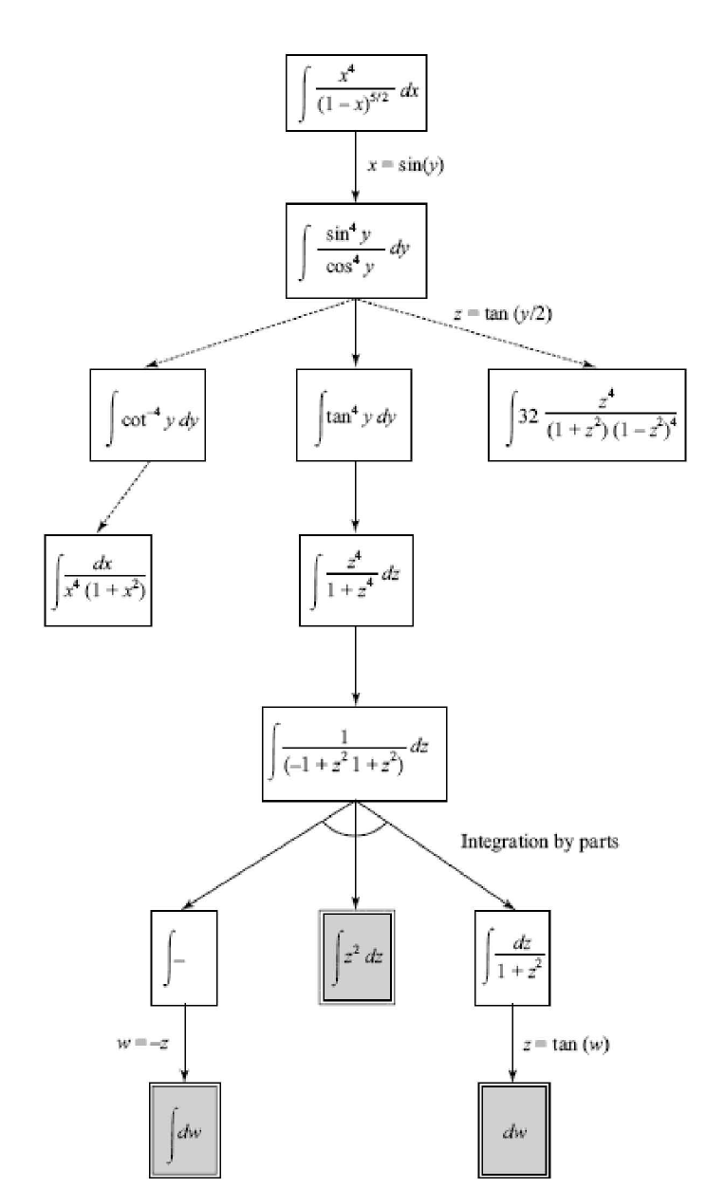
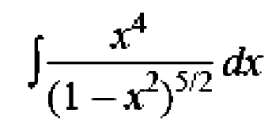
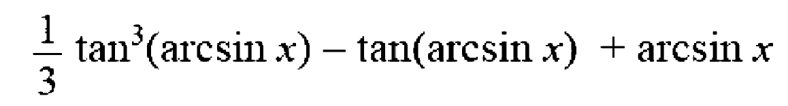
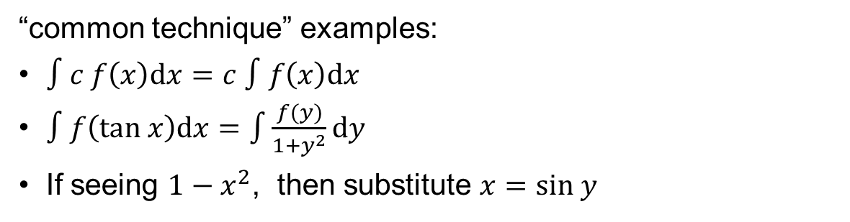
Example: SAINT (Slagle, 1961)
Symbolic Integrator
States: symbolic expression
Actions: “common techniques”
Successor: the new expression after applying the technique
Goal test: whether the expression is in “standard form”
“common technique” examples:
$∫c f\left(x\right)dx=c ∫f\left(x\right)dx$
$∫f\left(tan x\right)dx=\int{\frac{f(y)}{1+y^{2}}}dy$
If seeing $1−x^{2}$, then substitute $x=sin y$

Slide 8
Example: Machine translation
Translate “你好嗎” to English
States: current word sequence
Actions: the next word
Successor: the concatenation of current sequence and next word
Goal test: whether the current sequence means the same as 你好嗎
Why is you
Why is
Why is I
Why
Why are
Why are you
Why are I
What is
What
What are
How
How is
……
How are

Slide 9
Topics
BFS
DFS
UCS (Dijkstra Algorithm)
Difference with DSA2:
The state space is exponentially large, and it’s unlikely we’ll store the whole state space in memory

Slide 10
General Framework

Slide 11
State Space and Search Tree
State Space Graph
Each NODE in in the search tree is an entire PATH in the state space graph.
Search Tree
S
a
G
d
e
p
b
c
b
c
e
h
r
q
d
e
f
a
a
h
r
p
q
f
S
h
We construct both on demand – and we construct as little as possible.
p
r
p
q
f
q
c
G
q
a
q
c
G
a

Slide 12







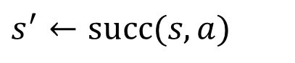
A General Framework
Expanded $←$ { }
Frontier $←$ { initial_state }
While Frontier is not empty:
Choose a node $s$ from Frontier
①
For all action $a$:
$$s^{′}←succ(s,a)$$
②
If $s′$ has not been reached
Put $s′$ in Frontier
Move $s$ to Expanded
③
All nodes that are not in Expanded or Frontier
Nodes are divided into 3 groups: Expanded, Frontier, and Unreached.

Slide 13
⓪ Place the initial state in Frontier

Slide 14

① Choose a node $s$ from Frontier

Slide 15
② Move all unreached successors of $s$ to Frontier

Slide 16

③ Move $s$ to Expanded

Slide 17
① Choose a node $s$ from Frontier

Slide 18
② Move all unreached successors of $s$ to Frontier

Slide 19
③ Move $s$ to Expanded

Slide 20
① Choose a node $s$ from Frontier

Slide 21
② Move all unreached successors of $s$ to Frontier

Slide 22
③ Move $s$ to Expanded

Slide 23
① Choose a node $s$ from Frontier

Slide 24
② Move all unreached successors of $s$ to Frontier

Slide 25
③ Move $s$ to Expanded

Slide 26






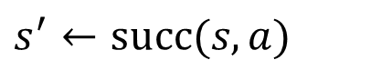



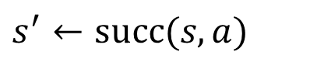




Implementation
Choose and then remove it
Expanded $←$ { }
Frontier $←$ { initial_state }
Frontier $←$ { initial_state }
While Frontier is not empty:
While Frontier is not empty:
Choose a node $s$ from Frontier
Pop a node $s$ from Frontier
For all action $a$:
For all action $a$:
$$s^{′}←succ(s,a)$$
$$s^{′}←succ(s,a)$$
If $s′$ has not been reached:
If not Reached[$s′$]:
Put $s′$ in Frontier
Put $s′$ in Frontier
Reached[$s′$] $←$ True
Move $s$ to Expanded

Slide 27
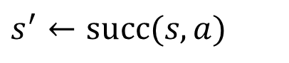











Termination When Goal is Encountered
Frontier $←$ { initial_state }
Frontier $←$ { initial_state }
While Frontier is not empty:
While Frontier is not empty:
Pop a node $s$ from Frontier
Pop a node $s$ from Frontier
If $s$ is a goal state, terminate
For all action $a$:
For all action $a$:
$$s^{′}←succ(s,a)$$
$$s^{′}←succ(s,a)$$
If not Reached[$s′$]:
If not Reached[$s′$]:
If $s′$ is a goal state, terminate
Put $s′$ in Frontier
Push $s′$ to Frontier
Reached[$s′$] $←$ True
Reached[$s′$] $←$ True
Late Goal Test
Early Goal Test

Slide 28
Termination When Goal is Encountered
Early Goal Test allows quicker termination when a goal is found.
Breadth First Search
Depth First Search
However, when actions are associated with costs and we want to find a minimum cost solution (i.e., cost-sensitive), we may have to use the Late Goal Test.
Uniform Cost Search (Dijkstra Algorithm)

Slide 29
Uninformed Search

Slide 30
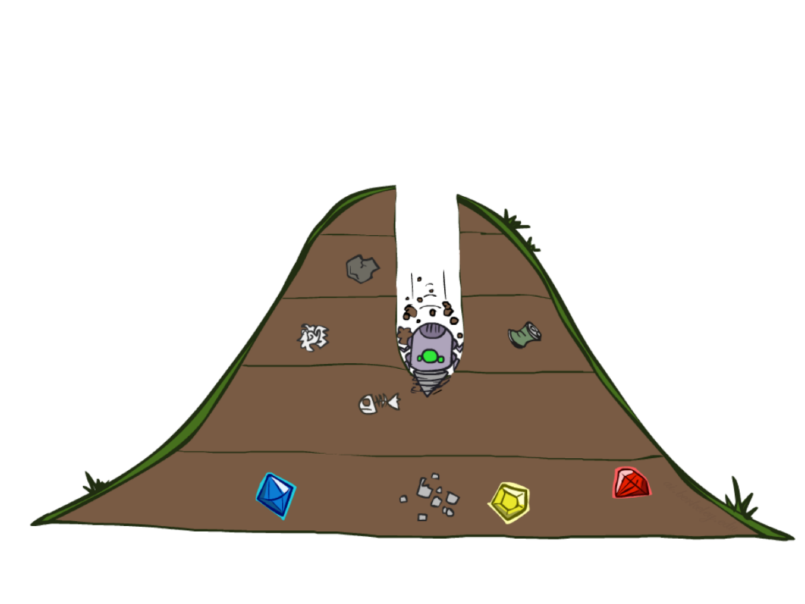
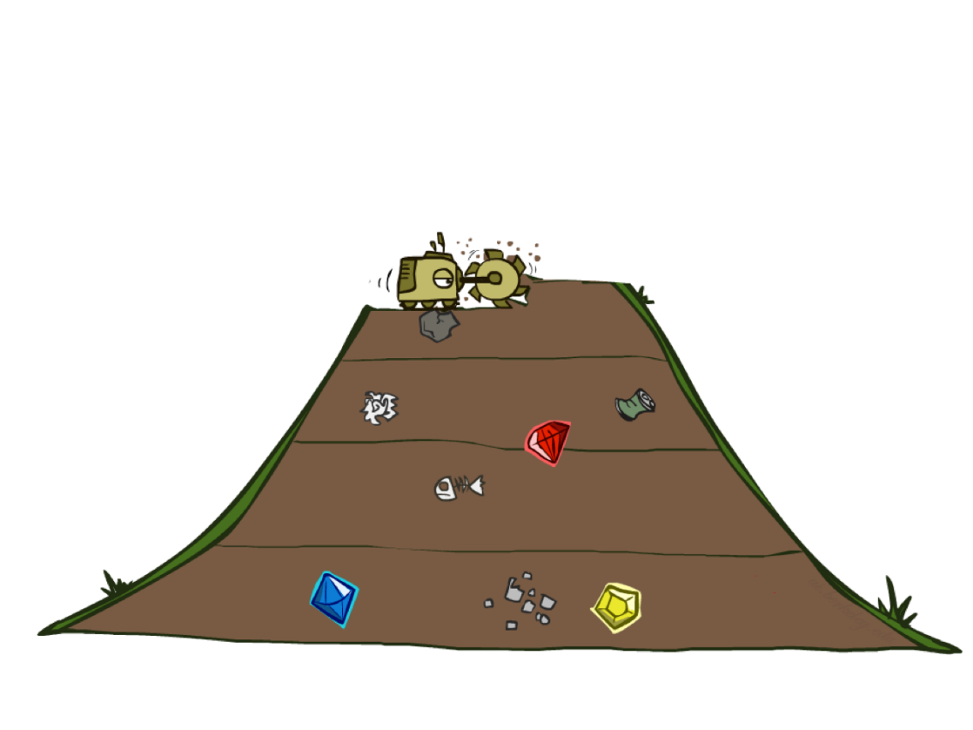
DFS and BFS
Depth First Search
Breadth First Search

Slide 31
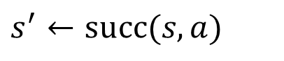







DFS and BFS
Frontier $←$ { initial_state }
While Frontier is not empty:
Pop a node $s$ from Frontier
differ here
For all action $a$:
$$s^{′}←succ(s,a)$$
If not Reached[$s′$]:
If $s′$ is a goal state, terminate
Push $s′$ to Frontier
Reached[$s′$] $←$ True

Slide 32

DFS
Frontier $←$ { initial_state }
While Frontier is not empty:
Pop the newest node $s$ from Frontier
For all action $a$:
$$s^{′}←succ(s,a)$$
If not Reached[$s′$]:
If $s′$ is a goal state, terminate
Push $s′$ to Frontier
Reached[$s′$] $←$ True

Slide 33
DFS
a
G
b
c
d
e
f
S
h
p
q
r
S
d
e
p
b
c
e
h
r
q
a
a
h
r
p
q
f
p
q
f
q
c
G
q
c
G
a
a

Slide 34
DFS
a
G
b
c
d
e
f
S
h
p
q
r
S
d
e
p
b
c
e
h
r
q
a
a
h
r
p
q
f
p
q
f
q
c
G
q
c
G
a
a

Slide 35
DFS
a
G
b
c
d
e
f
S
h
p
q
r
S
d
e
p
b
c
e
h
r
q
a
a
h
r
p
q
f
p
q
f
q
c
G
q
c
G
a
a

Slide 36
DFS
a
G
b
c
d
e
f
S
h
p
q
r
S
d
e
p
b
c
e
h
r
q
a
a
h
r
p
q
f
p
q
f
q
c
G
q
c
G
a
a

Slide 37
DFS
a
G
b
c
d
e
f
S
h
p
q
r
S
d
e
p
b
c
e
h
r
q
a
a
h
r
p
q
f
p
q
f
q
c
G
q
c
G
a
a

Slide 38
DFS
a
G
b
c
d
e
f
S
h
p
q
r
S
d
e
p
b
c
e
h
r
q
a
a
h
r
p
q
f
p
q
f
q
c
G
q
c
G
a
a

Slide 39
DFS
a
G
b
c
d
e
f
S
h
p
q
r
S
d
e
p
b
c
e
h
r
q
a
a
h
r
p
q
f
p
q
f
q
c
G
q
c
G
a
a

Slide 40
DFS
a
G
b
c
d
e
f
S
h
p
q
r
S
d
e
p
b
c
e
h
r
q
a
a
h
r
p
q
f
p
q
f
q
c
G
q
c
G
a
a

Slide 41
DFS
a
G
b
c
d
e
f
S
h
p
q
r
S
d
e
p
b
c
e
h
r
q
a
a
h
r
p
q
f
p
q
f
q
c
G
q
c
G
a
a

Slide 42
DFS
a
G
b
c
d
e
f
S
h
p
q
r
S
d
e
p
b
c
e
h
r
q
a
a
h
r
p
q
f
p
q
f
q
c
G
q
c
G
a
a

Slide 43
DFS
a
G
b
c
d
e
f
S
h
p
q
r
S
d
e
p
b
c
e
h
r
q
a
a
h
r
p
q
f
p
q
f
q
c
G
q
c
G
a
a

Slide 44
DFS
a
G
b
c
d
e
f
S
h
p
q
r
S
d
e
p
b
c
e
h
r
q
a
a
h
r
p
q
f
p
q
f
q
c
G
q
c
G
a
a

Slide 45

BFS
Frontier $←$ { initial_state }
While Frontier is not empty:
Pop the oldest node $s$ from Frontier
For all action $a$:
$$s^{′}←succ(s,a)$$
If not Reached[$s′$]:
If $s′$ is a goal state, terminate
Push $s′$ to Frontier
Reached[$s′$] $←$ True

Slide 46
BFS
a
G
b
c
d
e
f
S
h
p
q
r
S
d
e
p
b
c
e
h
r
q
a
a
h
r
p
q
f
p
q
f
q
c
G
q
c
G
a
a

Slide 47
BFS
a
G
b
c
d
e
f
S
h
p
q
r
S
d
e
p
b
c
e
h
r
q
a
a
h
r
p
q
f
p
q
f
q
c
G
q
c
G
a
a

Slide 48
BFS
a
G
b
c
d
e
f
S
h
p
q
r
S
d
e
p
b
c
e
h
r
q
a
a
h
r
p
q
f
p
q
f
q
c
G
q
c
G
a
a

Slide 49
BFS
a
G
b
c
d
e
f
S
h
p
q
r
S
d
e
p
b
c
e
h
r
q
a
a
h
r
p
q
f
p
q
f
q
c
G
q
c
G
a
a

Slide 50
BFS
a
G
b
c
d
e
f
S
h
p
q
r
S
d
e
p
b
c
e
h
r
q
a
a
h
r
p
q
f
p
q
f
q
c
G
q
c
G
a
a

Slide 51
BFS
a
G
b
c
d
e
f
S
h
p
q
r
S
d
e
p
b
c
e
h
r
q
a
a
h
r
p
q
f
p
q
f
q
c
G
q
c
G
a
a

Slide 52
BFS
a
G
b
c
d
e
f
S
h
p
q
r
S
d
e
p
b
c
e
h
r
q
a
a
h
r
p
q
f
p
q
f
q
c
G
q
c
G
a
a

Slide 53
BFS
a
G
b
c
d
e
f
S
h
p
q
r
S
d
e
p
b
c
e
h
r
q
a
a
h
r
p
q
f
p
q
f
q
c
G
q
c
G
a
a

Slide 54
BFS
a
G
b
c
d
e
f
S
h
p
q
r
S
d
e
p
b
c
e
h
r
q
a
a
h
r
p
q
f
p
q
f
q
c
G
q
c
G
a
a

Slide 55
BFS
a
G
b
c
d
e
f
S
h
p
q
r
S
d
e
p
b
c
e
h
r
q
a
a
h
r
p
q
f
p
q
f
q
c
G
q
c
G
a
a

Slide 56
BFS
a
G
b
c
d
e
f
S
h
p
q
r
S
d
e
p
b
c
e
h
r
q
a
a
h
r
p
q
f
p
q
f
q
c
G
q
c
G
a
a

Slide 57
BFS
a
G
b
c
d
e
f
S
h
p
q
r
S
d
e
p
b
c
e
h
r
q
a
a
h
r
p
q
f
p
q
f
q
c
G
q
c
G
a
a

Slide 58
BFS
a
G
b
c
d
e
f
S
h
p
q
r
S
d
e
p
b
c
e
h
r
q
a
a
h
r
p
q
f
p
q
f
q
c
G
q
c
G
a
a

Slide 59
DFS vs. BFS
In what cases is DFS quicker to find the goal?
In what cases is BFS quicker to find the goal?

Slide 60
DFS vs. BFS
Does DFS / BFS find the goal with the smallest depth?
…

Slide 61
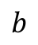
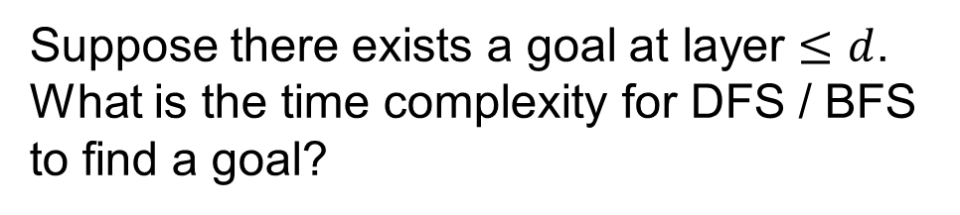
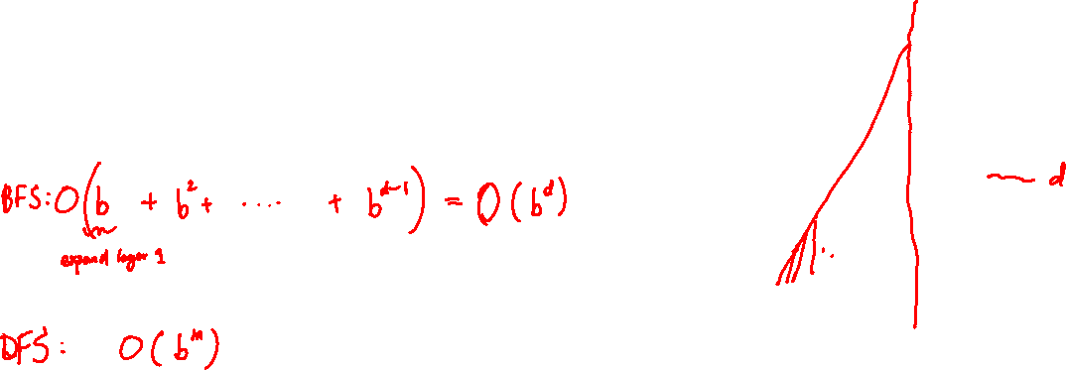
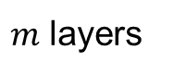
DFS vs. BFS
Suppose there exists a goal at layer $≤d$. What is the time complexity for DFS / BFS to find a goal?
$$b$$
…
$m$ layers
b: branching factor
m: maximum depth
Goals at various depths

Slide 62
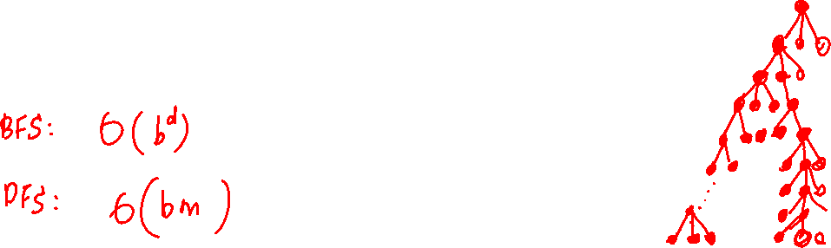
DFS vs. BFS
What’s the maximum possible size of Frontier in DFS / BFS?
$$b$$
…
$m$ layers
b: branching factor
m: maximum depth
Goals at various depths

Slide 63
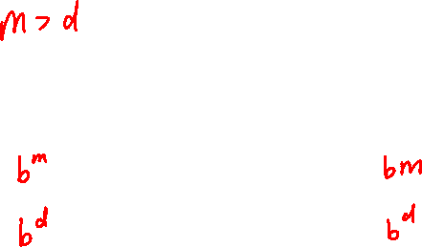
DFS vs. BFS
 | Time | Frontier Size
DFS
BFS
So DFS can be more memory-efficient than BFS?
Yes … but not with our current implementation

Slide 64



DFS
Frontier $←$ { initial_state }
While Frontier is not empty:
Pop the newest node $s$ from Frontier
For all action $a$:
$$s^{′}←succ(s,a)$$
If not Reached[$s′$]:
If $s′$ is a goal state, terminate
Push $s′$ to Frontier
Reached[$s′$] $←$ True

Slide 65


DFS
Frontier $←$ { initial_state }
While Frontier is not empty:
Pop the newest node $s$ from Frontier
For all action $a$:
$$s^{′}←succ(s,a)$$
If $s′$ is a goal state, terminate
Push $s′$ to Frontier
Because we omit the check, the algorithm may end up search in same sub-trees multiple times.
A Memory Efficient Version of DFS for Acyclic Graphs

Slide 66
Previous DFS Example
a
G
b
c
d
e
f
S
h
p
q
r
S
d
e
p
b
c
e
h
r
q
a
a
h
r
p
q
f
p
q
f
q
c
G
q
c
G
a
a

Slide 67




DFS
Frontier $←$ { initial_state }
While Frontier is not empty:
Pop the newest node $s$ from Frontier
For all action $a$:
$$s^{′}←succ(s,a)$$
If $s′$ is not an ancestor of $s$:
If $s′$ is a goal state, terminate
Push $s′$ to Frontier
A Memory Efficient Version of DFS for Cyclic Graphs

Slide 68
(Memory Efficient) DFS
a
c
e
handling cycles
S
G
b
d
f
s

Slide 69
(Memory Efficient) DFS
a
c
e
handling cycles
S
G
b
d
f
s

Slide 70
(Memory Efficient) DFS
a
c
e
handling cycles
S
G
b
d
f
s
sa

Slide 71
(Memory Efficient) DFS
a
c
e
handling cycles
S
G
b
d
f
s
sa
sab
sac

Slide 72
(Memory Efficient) DFS
a
c
e
handling cycles
S
G
b
d
f
s
sa
sab
sac

Slide 73
(Memory Efficient) DFS
a
c
e
handling cycles
S
G
b
d
f
s
sa
sab
sac
sacd
sace

Slide 74
(Memory Efficient) DFS
a
c
e
handling cycles
S
G
b
d
f
s
sa
sab
sac
sacd
sace
sacdb

Slide 75
(Memory Efficient) DFS
a
c
e
handling cycles
S
G
b
d
f
s
sa
sab
sac
sacd
sace
sacdb

Slide 76
(Memory Efficient) DFS
a
c
e
handling cycles
S
G
b
d
f
s
sa
sab
sac
sacd
sace
sacdb
sacef

Slide 77
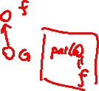
(Memory Efficient) DFS
a
c
e
handling cycles
S
G
b
d
f
s
sa
sab
sac
sacd
sace
sacdb
sacef
sacefd
sacefG

Slide 78
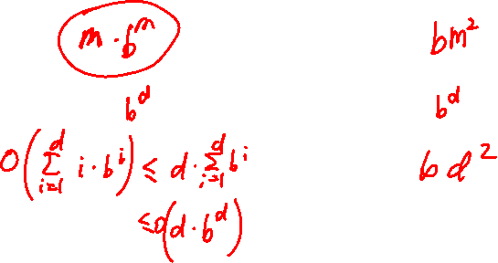

DFS vs. BFS
 | Time | Space
DFS (memory-efficient version)
BFS
IDS

Slide 79
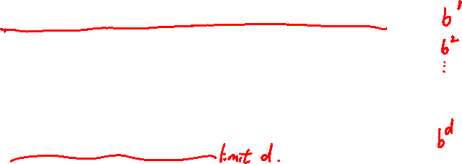
Iterative Deepening Search (IDS)
Idea: get DFS’s space advantage with BFS’s time advantage
Run a DFS with depth limit 1. If no solution…
Run a DFS with depth limit 2. If no solution…
Run a DFS with depth limit 3. …..
Isn’t that wastefully redundant?
Generally most work happens in the last level
Branching factor 10, solution 5 deep:
BFS: 10 + 100 + 1,000 + 10,000 + 100,000 = 111,110
IDS: 50 + 400 + 3,000 + 20,000 + 100,000 = 123,450

Slide 80

Which One is DFS/BFS?

Slide 81
Cost-Sensitive Search Problem
a
G
2
2
b
c
3
1
8
2
2
e
d
f
3
10
9
8
2
S
h
1
4
2
p
4
r
15
q

Slide 82
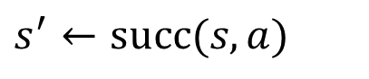









Uniform Cost Search (Dijkstra)
Frontier $←$ { initial_state }
While Frontier is not empty:
Pop a node $s$ from Frontier
Choose the one with smallest $g\left(s\right)$
If $s$ is a goal state, then terminate
For all action $a$:
$$s^{′}←succ(s,a)$$
If not Reached[$s′$]:
Put $s′$ in Frontier
Reached[$s′$] $←$ True
$$g\left(s′\right)←min \left\{ g\left(s′\right) , g\left(s\right)+cost\left(s,a\right) \right\}$$

Slide 83
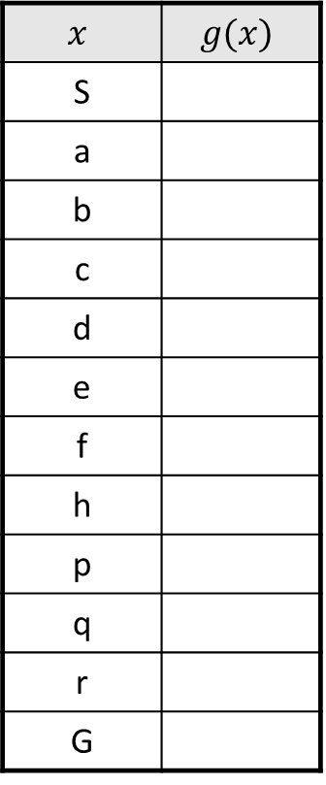
UCS
$$x$$ | $$g(x)$$
S
a
b
c
d
e
f
h
p
q
r
G
a
G
2
2
b
c
3
1
8
2
2
e
d
f
3
10
9
8
2
S
h
1
4
2
p
4
r
15
q

Slide 84
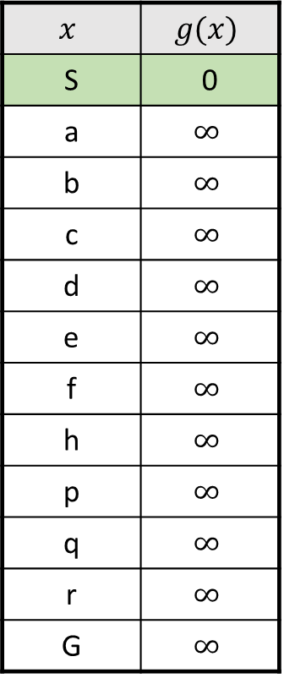
UCS
$$x$$ | $$g(x)$$
S | 0
a | $$∞$$
b | $$∞$$
c | $$∞$$
d | $$∞$$
e | $$∞$$
f | $$∞$$
h | $$∞$$
p | $$∞$$
q | $$∞$$
r | $$∞$$
G | $$∞$$
a
G
2
2
b
c
3
1
8
2
2
e
d
f
3
10
9
8
2
S
h
1
4
2
p
4
r
15
q

Slide 85
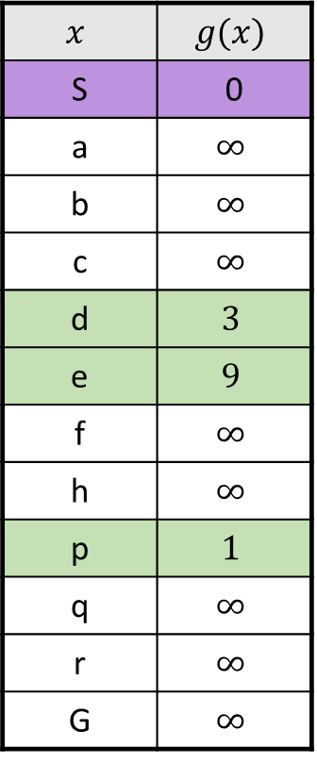
UCS
$$x$$ | $$g(x)$$
S | 0
a | $$∞$$
b | $$∞$$
c | $$∞$$
d | $$3$$
e | $$9$$
f | $$∞$$
h | $$∞$$
p | $$1$$
q | $$∞$$
r | $$∞$$
G | $$∞$$
a
G
2
2
b
c
3
1
8
2
2
e
d
f
3
10
9
8
2
S
h
1
4
2
p
4
r
15
q

Slide 86
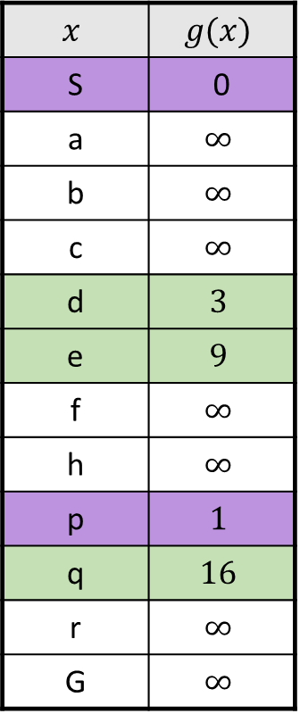
UCS
$$x$$ | $$g(x)$$
S | 0
a | $$∞$$
b | $$∞$$
c | $$∞$$
d | $$3$$
e | $$9$$
f | $$∞$$
h | $$∞$$
p | $$1$$
q | $$16$$
r | $$∞$$
G | $$∞$$
a
G
2
2
b
c
3
1
8
2
2
e
d
f
3
10
9
8
2
S
h
1
4
2
p
4
r
15
q

Slide 87
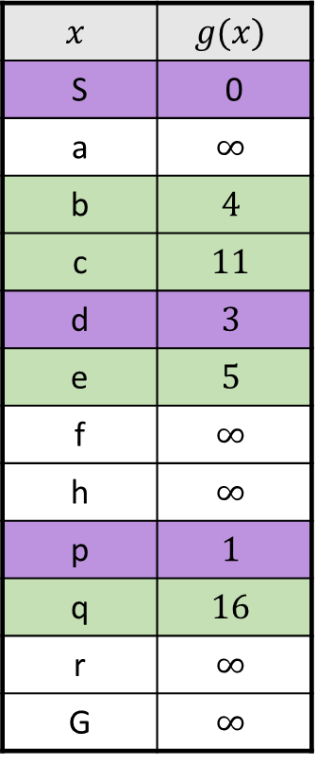
UCS
$$x$$ | $$g(x)$$
S | 0
a | $$∞$$
b | $$4$$
c | $$11$$
d | $$3$$
e | $$5$$
f | $$∞$$
h | $$∞$$
p | $$1$$
q | $$16$$
r | $$∞$$
G | $$∞$$
a
G
2
2
b
c
3
1
8
2
2
e
d
f
3
10
9
8
2
S
h
1
4
2
p
4
r
15
q

Slide 88
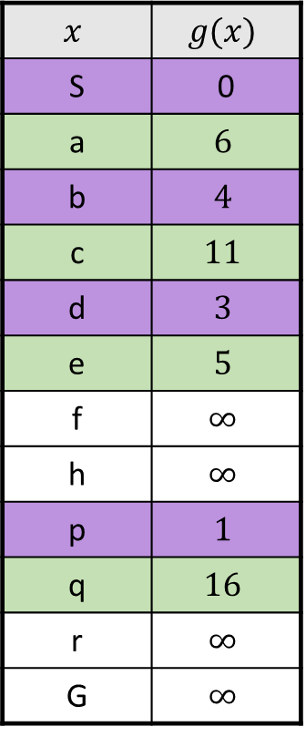
UCS
$$x$$ | $$g(x)$$
S | 0
a | $$6$$
b | $$4$$
c | $$11$$
d | $$3$$
e | $$5$$
f | $$∞$$
h | $$∞$$
p | $$1$$
q | $$16$$
r | $$∞$$
G | $$∞$$
a
G
2
2
b
c
3
1
8
2
2
e
d
f
3
10
9
8
2
S
h
1
4
2
p
4
r
15
q

Slide 89
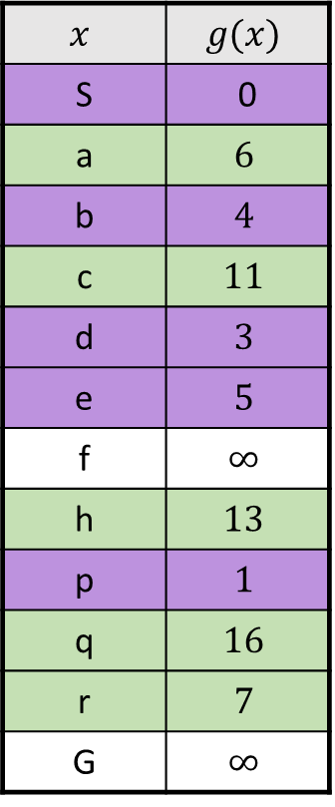
UCS
$$x$$ | $$g(x)$$
S | 0
a | $$6$$
b | $$4$$
c | $$11$$
d | $$3$$
e | $$5$$
f | $$∞$$
h | $$13$$
p | $$1$$
q | $$16$$
r | $$7$$
G | $$∞$$
a
G
2
2
b
c
3
1
8
2
2
e
d
f
3
10
9
8
2
S
h
1
4
2
p
4
r
15
q

Slide 90
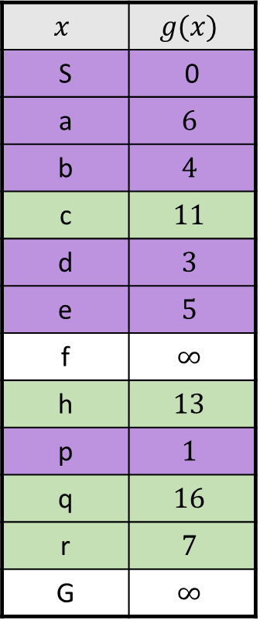
UCS
$$x$$ | $$g(x)$$
S | 0
a | $$6$$
b | $$4$$
c | $$11$$
d | $$3$$
e | $$5$$
f | $$∞$$
h | $$13$$
p | $$1$$
q | $$16$$
r | $$7$$
G | $$∞$$
a
G
2
2
b
c
3
1
8
2
2
e
d
f
3
10
9
8
2
S
h
1
4
2
p
4
r
15
q

Slide 91
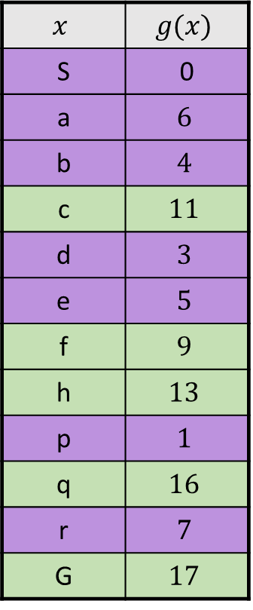
UCS
$$x$$ | $$g(x)$$
S | 0
a | $$6$$
b | $$4$$
c | $$11$$
d | $$3$$
e | $$5$$
f | $$9$$
h | $$13$$
p | $$1$$
q | $$16$$
r | $$7$$
G | $$17$$
a
G
2
2
b
c
3
1
8
2
2
e
d
f
3
10
9
8
2
S
h
1
4
2
p
4
r
15
q

Slide 92
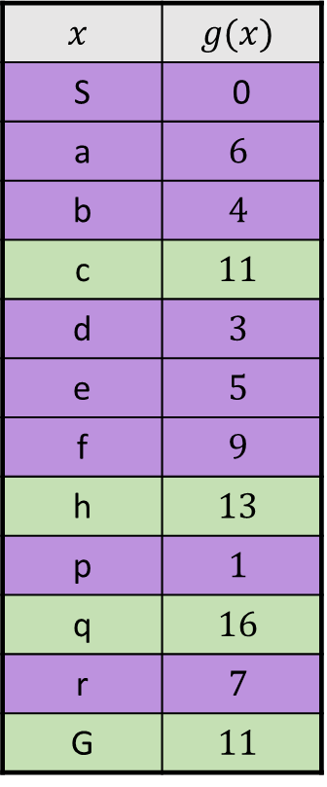
UCS
$$x$$ | $$g(x)$$
S | 0
a | $$6$$
b | $$4$$
c | $$11$$
d | $$3$$
e | $$5$$
f | $$9$$
h | $$13$$
p | $$1$$
q | $$16$$
r | $$7$$
G | $$11$$
a
G
2
2
b
c
3
1
8
2
2
e
d
f
3
10
9
8
2
S
h
1
4
2
p
4
r
15
q

Slide 93
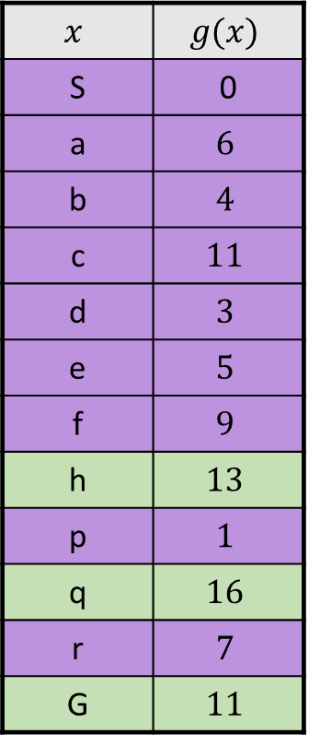
UCS
$$x$$ | $$g(x)$$
S | 0
a | $$6$$
b | $$4$$
c | $$11$$
d | $$3$$
e | $$5$$
f | $$9$$
h | $$13$$
p | $$1$$
q | $$16$$
r | $$7$$
G | $$11$$
a
G
2
2
b
c
3
1
8
2
2
e
d
f
3
10
9
8
2
S
h
1
4
2
p
4
r
15
q

Slide 94
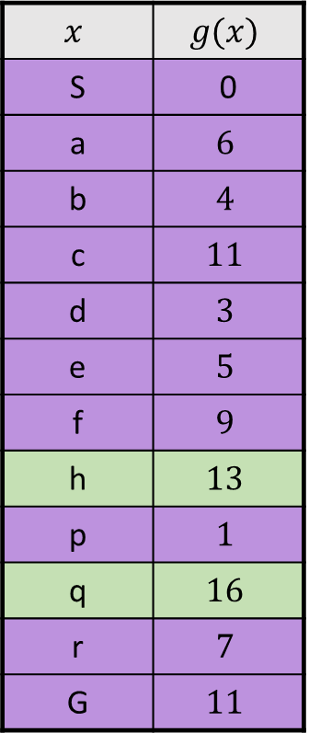
UCS
$$x$$ | $$g(x)$$
S | 0
a | $$6$$
b | $$4$$
c | $$11$$
d | $$3$$
e | $$5$$
f | $$9$$
h | $$13$$
p | $$1$$
q | $$16$$
r | $$7$$
G | $$11$$
a
G
2
2
b
c
3
1
8
2
2
e
d
f
3
10
9
8
2
S
h
1
4
2
p
4
r
15
q

Slide 95
DFS/BFS/UCS? (Deep/light blue → high/low cost)

Slide 96
DFS/BFS/UCS? (Deep/light blue → high/low cost)

Slide 97
DFS/BFS/UCS? (Deep/light blue → high/low cost)

Slide 98
Informed Search

Slide 99
Inefficiency of the Search Algorithms We See So Far

Slide 100
Inefficiency of the Search Algorithms We See So Far

Slide 101
Heuristic Function
Suppose we have some “guess” for the distance from every node to the goal.
Can we leverage it to accelerate the search?
n₁
50
6
S
G
20
n₂
8

Slide 102

Heuristic Function
Having a heuristic function that accurately predict the distance might be impossible.
However, some function that correlates with the true distance may be easy to find.
10
5
11.2

Slide 103






Greedy Best-First Search
Suppose we have a heuristic function $h\left(s\right)$.
Frontier $←$ { initial_state }
While Frontier is not empty:
Pop a node $s$ from Frontier
Choose the one with smallest $h\left(s\right)$
For all action $a$:
$$s^{′}←succ(s,a)$$
If not Reached[$s′$]:
If $s′$ is a goal state, then terminate
Push $s′$ to Frontier
Reached[$s′$] $←$ True

Slide 104
Greedy Best-First Search
b
…
If the heuristic is good
Take us directly to the goal
Like a nicely-guided DFS
In the worst case
Take us to the wrong way
Like a badly-guided DFS
b
…

Slide 105





A* Search: Combining Greedy and UCS
Suppose we have a heuristic function $h\left(s\right)$.
Backward cost
Forward cost
Frontier $←$ { initial_state }
While Frontier is not empty:
Pop a node $s$ from Frontier
Choose the one with smallest $g\left(s\right)+h\left(s\right)$
If $s$ is a goal state, then terminate
UCS is a special case with $h\left(s\right)=0$
For all action $a$:
$$s^{′}←succ(s,a)$$
If not Reached[$s′$]:
Push $s′$ to Frontier
Reached[$s′$] $←$ True
$$g\left(s′\right)←min \left\{ g\left(s′\right) , g\left(s\right)+cost\left(s,a\right) \right\}$$

Slide 106
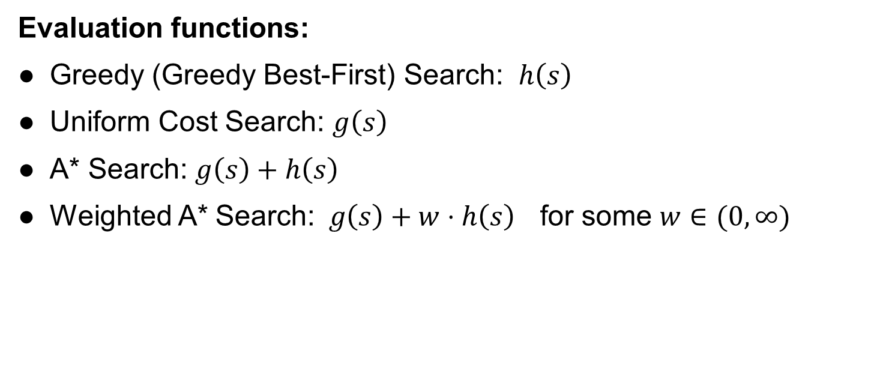
A* Search
Evaluation functions:
Greedy (Greedy Best-First) Search: $h\left(s\right)$
Uniform Cost Search: $g\left(s\right)$
A* Search: $g\left(s\right)+h\left(s\right)$
Weighted A* Search: $g\left(s\right)+w⋅h\left(s\right)$ for some $w∈(0,∞)$

Slide 107
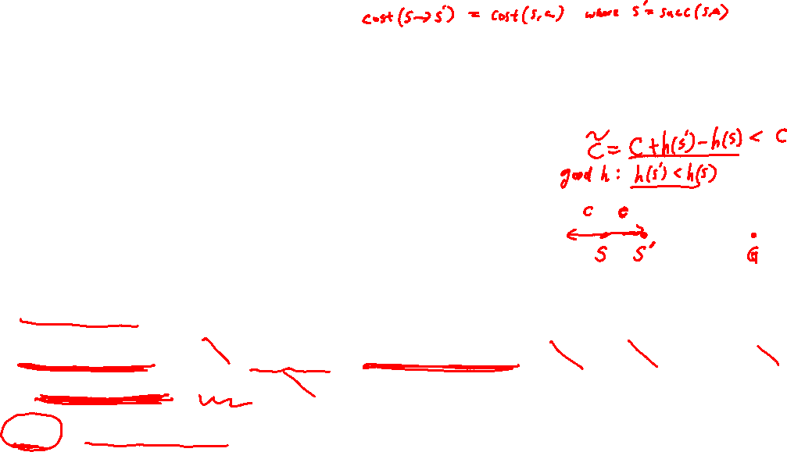
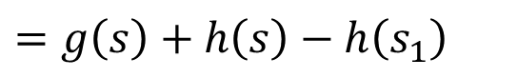
A* Search
A* Search = Uniform Cost Search with modified cost
$$\tilde{cost}\left(s,a\right)=cost\left(s,a\right)+h\left(s′\right)−h(s)$$
Proof
Let $\tilde{g}\left(s\right)$ be the values of UCS with the modified loss
$$\tilde{g}\left(s\right)=\tilde{cost}\left(s_{1}→s_{2}\right)+\tilde{cost}\left(s_{2}→s_{3}\right)+⋯+\tilde{cost}\left(s_{m}→s\right)$$
$$=\left[cost\left(s_{1}→s_{2}\right)+h\left(s_{2}\right)−h(s_{1})\right]+\left[cost\left(s_{2}→s_{3}\right)+h\left(s_{3}\right)−h(s_{2})\right] +⋯$$
$+\left[cost\left(s_{m}→s\right)+h\left(s\right)−h(s_{m})\right]$
$$=g\left(s\right)+h\left(s\right)−h\left(s_{1}\right)$$
s₂
s₃
s₁
s_{m}
s
initial state

Slide 108
UCS vs. A*
Start
Start
Goal
Goal
UCS
A*

Slide 109
UCS / Greedy Best-First / A* ?

Slide 110
UCS / Greedy Best-First / A* ?

Slide 111
UCS / Greedy Best-First / A* ?

Slide 112



Comparison
Greedy
UCS
A*

Slide 113
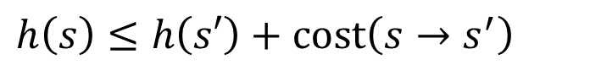
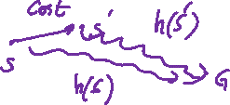
The Optimality of A*
Definitions
A heuristic function $h$ is called consistent if for all $s$ and $s′$
$$h\left(s\right)≤h\left(s′\right)+cost\left(s→s^{′}\right)$$
(triangle inequality)
and $h\left(G\right)=0$ for any goal state $G$.

Slide 114

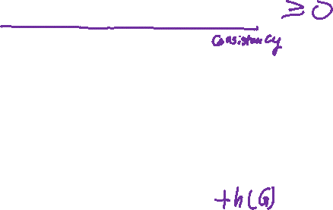
The Optimality of A*
Theorem
If the heuristic function is consistent, then A* returns minimum-cost solution.
Proof
A* is equivalent to UCS with $\tilde{cost}\left(s→s′\right):=cost\left(s→s′\right)+h\left(s′\right)−h(s)$
Total modified cost of any path $s_{1}→s_{2}→⋯→s_{m}→G$ is
$$\tilde{cost}\left(s_{1}→s_{2}\right)+\tilde{cost}\left(s_{2}→s_{3}\right)+⋯+\tilde{cost}\left(s_{m}→G\right)$$
$$=\left[cost\left(s_{1}→s_{2}\right)+h\left(s_{2}\right)−h(s_{1})\right]+\left[cost\left(s_{2}→s_{3}\right)+h\left(s_{3}\right)−h(s_{2})\right]+⋯$$
$+\left[cost\left(s_{m}→G\right)+h\left(G\right)−h(s_{m})\right]$
$$=cost\left(s_{1}→s_{2}\right)+cost\left(s_{2}→s_{3}\right)+⋯+cost\left(s_{m}→G\right)−h(s_{1})$$
Since $\tilde{cost}\left(s→s′\right)≥0$ by the consistency of $h$, A*’s optimality follows UCS’s optimality under non-negative cost.

Slide 115
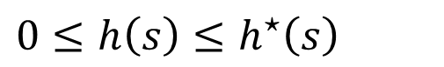
The Optimality of A*
Definitions
A heuristic function $h$ is called admissible if for all $s$
$$0≤h\left(s\right)≤h^{⋆}\left(s\right)$$
where $h^{⋆}\left(s\right)$ is the true minimum distance from $s$ to goal.
Theorems
If $h$ is consistent, then it is also admissible.
If the heuristic function is admissible and the graph is a tree, then A* returns minimum-cost solution.

Slide 116
The Optimality of A*
For general graphs, we can treat it like a tree by omitting the condition “if not Reached[s’]” in the graph search algorithm (like what we did for memory-efficient DFS).
This allows us to apply the theorem in the previous page.
S
a
G
d
e
p
b
c
b
c
e
h
r
q
d
e
f
S
h
a
a
h
r
p
q
f
p
q
r
p
q
f
q
c
G
q
c
G
a
a

Slide 117
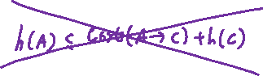
Admissible but not Consistent
A
1
S
1
C
h=4
h=1
h=2
1
2
B
3
h=1
G
h=0

Slide 118
Admissible but not Consistent
S (0+2)
A
1
S
1
C
h=4
h=1
h=2
1
2
B
3
h=1
G
Expanded = { }
h=0

Slide 119
Admissible but not Consistent
S (0+2)
A
1
A (1+4)
B (1+1)
S
1
C
h=4
h=1
h=2
1
2
B
3
h=1
G
Expanded = { S }
h=0

Slide 120
Admissible but not Consistent
S (0+2)
A
1
A (1+4)
B (1+1)
S
1
C
h=4
h=1
h=2
1
C (3+1)
2
B
3
h=1
G
Expanded = { S, B }
h=0

Slide 121
Admissible but not Consistent
S (0+2)
A
1
A (1+4)
B (1+1)
S
1
C
h=4
h=1
h=2
1
C (3+1)
2
B
3
G (6+0)
h=1
G
Expanded = { S, B, C }
h=0

Slide 122
Admissible but not Consistent
S (0+2)
A
1
A (1+4)
B (1+1)
S
1
C
h=4
h=1
h=2
1
C (2+1)
C (3+1)
2
B
3
G (6+0)
h=1
G
Expanded = { S, B, C }
h=0

Slide 123
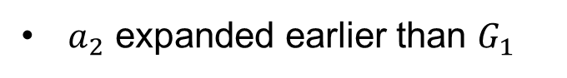




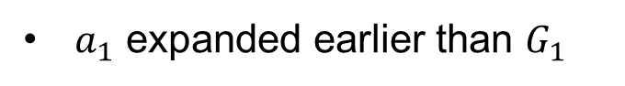

The Optimality of A*
Assume
$$dist\left(s,G_{2}\right)<dist\left(s,G_{1}\right)$$
By the tree structure, every node can only be reached by its unique predecessor
If admissible + tree, then A* returns minimum-cost solution.
$n$ expanded earlier than $G_{1}$
Proof by contradiction
$a_{1}$ expanded earlier than $G_{1}$
$$∵f\left(a_{1}\right)=g\left(a_{1}\right)+h\left(a_{1}\right)≤g\left(a_{1}\right)+h^{⋆}\left(a_{1}\right)$$
Path returned by A*
Optimal Path
$$=dist\left(s,G_{2}\right)<dist\left(s,G_{1}\right)≤g\left(G_{1}\right)=f(G_{1})$$
$a_{2}$ expanded earlier than $G_{1}$
n
$$∵f\left(a_{2}\right)=g\left(a_{2}\right)+h\left(a_{2}\right)≤g\left(a_{2}\right)+h^{⋆}\left(a_{2}\right)$$
s
$$=dist\left(s,G_{2}\right)<f(G_{1})$$
a₁
G₁
$$…$$
a₂
$a_{m−1}$ expanded earlier than $G_{1}$
a_{m-1}
G₂
$G_{2}$ expanded earlier than $G_{1}$

Slide 124
Creating Admissible/Consistent Heuristics
Most of the work in solving hard search problems is in coming up with admissible/consistent heuristics.
Often, admissible/consistent heuristics are solutions to relaxed problems, where new actions are available.
Inadmissible heuristics are often useful too.
366
15

Slide 125
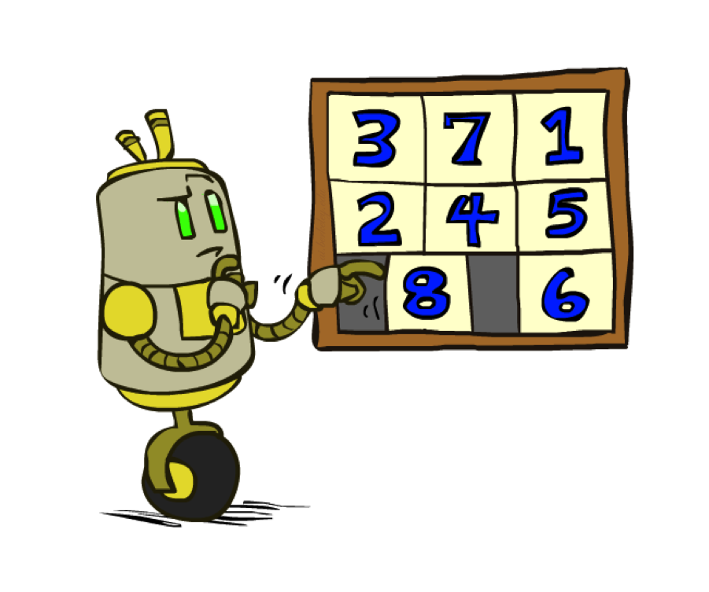
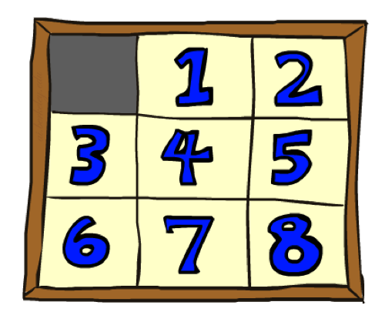
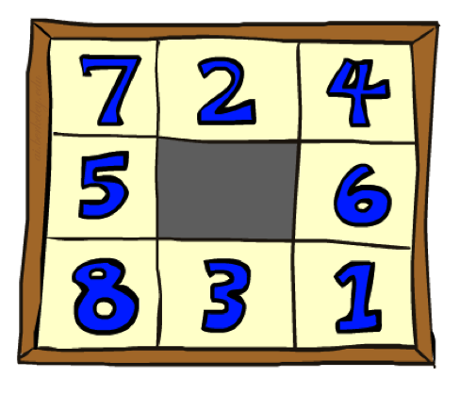
Example: 8 Puzzles
Goal State
Start State
 | Average nodes expanded when the optimal path has…
 | …4 steps | …8 steps | …12 steps
UCS | 112 | 6,300 | 3.6 x 10⁶
#wrong tile | 13 | 39 | 227
Manhattan | 12 | 25 | 73

Slide 126
Homework 1
Xuhui Kang, Haolin Liu
Deadline: 11:59PM, September 16

Slide 127
Homework 1
1. Choice Questions (10 points)
a. 14 questions.
b. Choice questions are 10 points in total and distributed evenly
2. Program Questions (25 points)

Slide 128
Homework 1: Choice Questions
Each question may be either single-choice or multiple-choice. Read carefully and select your answers accordingly.
Grading:
Full Credit: If all correct options are selected.
Partial Credit: If only some correct options are selected, with no wrong options chosen.
No Credit: If any incorrect options are selected.
Submission: Please answer directly on Gradescope. No need to submit a separate PDF.
Scores and correct answers will not be released immediately after submission.

Slide 129

Homework 1: Coding
In this problem, you are going to help Pacman find paths in a maze world by focusing on implementing search algorithms.
Autograder is given both offline and online in GradeScope. Your grade in gradescope is the final grade.

Slide 130

Homework 1: Coding
Question 1 -- 4: Implement Depth First Search, Breadth First Search, Uniform Cost Search, and A* algorithm. Your goal is to reach a target area.

Slide 131

Homework 1: Coding
Question 5 : The goal of this question is to visit all four corners rather than reaching a destination state.
Question 6: In the corner search problem, you need to implement an admissible heuristic function for A* algorithm.
You may need to consider more complex state space, which not only contain possible coordinate of the Pac-Man, but tracking the visitation of corners as well.

Slide 132

Homework 1: Coding
Question 7 : The goal of this question is to find a way to eat all of the pellets in the maze. The position of the pellets is known to the pacman.

Slide 133

Homework 1: Coding
Question 8 : The goal of this question is to eat the closest dot (pellet) by finding the path to it.

